Slide 1
Introduction (Chapters 1 & 2)
Dr. Shengquan Wang
Most slides are adopted from
Artificial Intelligence: A Modern Approach, 4th ed. by Stuart Russell (UC Berkeley) and Peter Norvig (Google).
Peter Norvig and Sebastian Thrun for Intro to Artificial Intelligence at Udacity.
Dan Klein and Pieter Abbeel for CS188 Intro to AI at UC Berkeley.

Slide 2
Quiz
AI has successfully been used in
Finance
Robotics
Games
Medicine
The Web
Notes:
We can use AI to map one image to another image (like changing the character in a movie to look like someone else).
AI = prediction algorithms; basis of prediction is on distribution

Slide 3

AI in Finance
Rates
News
Stock Market
Bonds
Commodities
Trading Agent
Trading decisions
Trades

Slide 4

AI in Robotics
Cameras
Microphones
Touch
Environment
Motors
Voice
Notes:
Robot has sensors for input so that it can do analysis of environment.
…

Slide 5
AI in Games
You
Game Agent
Your move
decisions
Its move

Slide 6
AI in Medicine
Diagnostic Agent
Vital signals
Diagnostics
Notes:
*So far, we need doctors; but AI agents can assist the process for diagnostics.

Slide 7


AI in The Web
WWW
Crawler Agent
Web pages
DB
Query
Result
Notes:
*search engines

Slide 8
Outline
Intelligent Agent

Slide 9

An Intelligent Agent
Through many percepts/actions cycles
Program: control policy of the agent
Notes:
*AI = Artificial Intelligence; because it simulates intelligence; it is also called rationalization (rational = data and analysis on that data for a prediction for making a decision).
*actuator = output (actions)
*percepts = input (perceptions)
*control policy = code → ran on CPU (the “brain”).

Slide 10
Agent Types
Four basic types in order of increasing generality:
Simple reflex agents
Model-based reflex agents
Goal-based agents
Utility-based agents

Slide 11
Simple Reflex Agents
Reflex agents: Choose action based on current percept, ignoring the rest of the percept history.
Taxi driver: If car-in-front-is-braking then initiate-braking
Human analogy: The eye blinks when something approaches it.
Pros: Simple
Cons: limited intelligence
It will work only if the environment is fully observable.
Even a little bit of unobservability can cause serious trouble.
E.g., it is not always possible to tell from a single image whether the car is braking.
Notes:
*very simple “intelligence” since it is just reflexive (not much analysis involved at all)
Examples: blinking your eye (not using your entire thinking capabilities), vacuum cleaner moving towards nearest dirt

Slide 12
Model-based Reflex Agents
The agent should maintain some internal state that depends on the percept history.
E.g., changing lanes: the agent needs to keep track of where the other cars are if it can’t see them all at once.
Two kinds of knowledge are required:
How does the world evolve?
How does the agent’s action affect the world?
Notes:
*increase the complexity a step above just a pure reflex.
*uses some stored history of the environment (a model).
*now we are more interactive with the environment.

Slide 13
Goal-based Agents
Knowing something about the current state of the environment is not always enough to decide what to do.
The agent needs some sort of goal information that describes situations that are desirable
E.g., the passenger’s destination.
Notes:
*maintain a model, but increase complexity by introducing some general goal to achieve in the model.

Slide 14
Utility-based Agents
Goals alone are not enough to generate high-quality behavior in most environments.
Goals just provide a crude binary distinction between “happy” and “unhappy” states.
A fine-grained agent’s utility function is more desirable.
Notes:
*now we introduce a model where we conduct an optimization of the goal.

Slide 15
Outline
Intelligent Agent
Task Environment

Slide 16
Task Environment: PEAS
Performance measure
Environment
Actuators
Sensors

Slide 17
PEAS: Taxi Driver
Performance Measure | safe, fast, legal, comfortable trip, maximize profits
Environment | roads, other traffic, pedestrians, customers
Actuators | steering, accelerator, brake, signal, horn, display
Sensors | cameras, sonar, speedometer, GPS, odometer, accelerometer, engine sensors, keyboard
Notes:
*Actuators and Sensors is where we can introduce AI agents to assist our efforts.

Slide 18
PEAS: mowing lawn for a house yard
Performance Measure | Safe, fuel efficient, durability, longevity, grass mass cut per minute, effective cut height, moisture/dew grass cut capability
Environment | Lawns, rocks, trees, roots, yard obstacles, animals, other plants, people
Actuators | Blade, engine, starter, wheels, engagement levers
Sensors | Engine sensors (like fuel injection sensor, temperature sensor), grass mass sensor (if storage present), blade pressure sensor (for safety and keeping machine from damage)
Notes:
*Actuators and Sensors is where we can introduce AI agents to assist our efforts.

Slide 19
PEAS: translate English to Spanish
Performance Measure | Semantic accuracy of sentences, semantic accuracy of vocabulary, pronunciation, communicate idea effectively
Environment | People, words, sentences, writing medium, dictionary
Actuators | Translation engine output, tongue, hand, input for writing medium, ears, eyes
Sensors | Ears, eyes, translation engine input, reactions
Notes:
*Actuators and Sensors is where we can introduce AI agents to assist our efforts.

Slide 20
PEAS: Refinery Controller
Performance Measure | purity, yield, safety
Environment | refinery, operators
Actuators | valves, pumps, heaters, displays
Sensors | temperature, pressure, chemical sensors

Slide 21
Properties of Task Environments
Observable | Agent | Next state | State depend. | Changing environ. | State space
Fully | Single | Deterministic | Episodic | Static | Discrete
Partially | Multi | Stochastic | Sequential | Dynamic | Continuous

Slide 22
Examples
Taxi driving | Partially | Multi | Stochastic | Sequential | Dynamic | Continuous
Refinery controller
Partially | Single | Stochastic | Sequential | Dynamic | Continuous
Poker
Partially | Multi | Stochastic | Sequential | Static | Discrete

Slide 23
Environment Representation
The various ways that the components can represent the environment:
Atomic
Factored
Structured

Slide 24
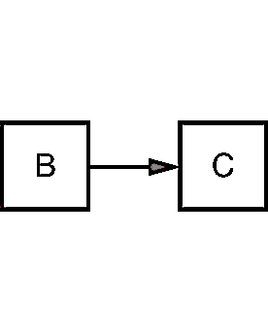
Example: Driving Route (1)
Atomic: the state of world to just the name of the city we are in.

Slide 25
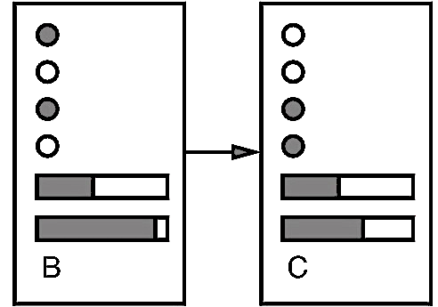
Example: Driving Route (2)
Factored:
how much gas is in the tank?
current GPS coordinates
whether or not the oil warning light is working?
how much spare change we have for toll crossings?
what station is on the radio?
…

Slide 26
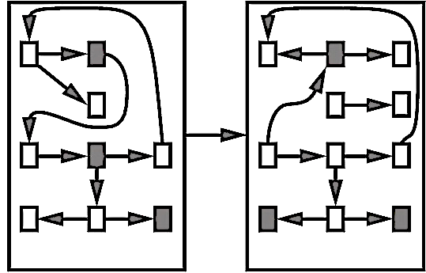
Example: Driving Route (3)
Structured: a large truck ahead of us is reversing into the driveway of a dairy farm but a cow has got loose and is blocking the truck’s path.
Notes:
*logic structures involved = most complex

